Slide 1

AUTOMATED SOFTWARE DEBLOAT
50% SEMINAR
Speaker: César Soto Valero
Supervisor: Benoit Baudry
Co-supervisors: Martin Monperrus, Thomas Durieux
Notes:
Hello everybody, my name is Cesar Soto Valero.
I'm here to present my 50% seminar with the title ”Automated Software Debloat”.
First of all, I want to say that I'm very happy to be here today because it means that I've spent exactly half of my time as a PhD student at KTH and... uff, that's a big thing.
I've had the honor of being supervised by Prof. Benoit Baudry, and Co-supervised by Martin Monperrus and Thomas Durieux.
Let's start by presenting the agenda for today.

Slide 2
AGENDA
Notes:
First, I’m going to give a very brief introduction to the topic of software bloat. I’m going to explain the problem and present the state-of-the-art.
Then, I’m going to present three key contributions that we have made so far on this topic:
A first contribution is a tool to automatically detect and remove bloated dependencies in Java projects.
The second contribution is a longitudinal analysis of bloated dependencies in which we show that it is safe to debloat this type of dependencies.
The third contribution is a dynamic debloat technique based on execution traces to debloat java bytecode.
After that, I’m going to present a summary and future work.
And finally, I’ll present some facts that show the status of my PhD.
IT IS SAFE TO DEBLOAT DEPENDENCIES
FIRST EMPIRICAL EVIDENCE OF EMPIRICAL FALSE ALARMS WHEN RISING ALERTS

Slide 3
AGENDA
INTRODUCTION AND STATE-OF-THE-ART

Slide 4
AGENDA
INTRODUCTION AND STATE-OF-THE-ART
CONTRIBUTIONS
Detecting and removing bloated dependencies
Longitudinal analysis of bloated dependencies
Trace-based debloat for Java bytecode

Slide 5
AGENDA
INTRODUCTION AND STATE-OF-THE-ART
CONTRIBUTIONS
Detecting and removing bloated dependencies
Longitudinal analysis of bloated dependencies
Trace-based debloat for Java bytecode
SUMMARY AND FUTURE WORK

Slide 6
AGENDA
INTRODUCTION AND STATE-OF-THE-ART
CONTRIBUTIONS
Detecting and removing bloated dependencies
Longitudinal analysis of bloated dependencies
Trace-based debloat for Java bytecode
SUMMARY AND FUTURE WORK
PHD PROGRESS

Slide 7
AGENDA
INTRODUCTION AND STATE-OF-THE-ART
CONTRIBUTIONS
Detecting and removing bloated dependencies
Longitudinal analysis of bloated dependencies
Trace-based debloat for Java bytecode
SUMMARY AND FUTURE WORK
PHD PROGRESS
Q&A

Slide 8
Software tends to grow over time, whether or not there's a need
for it.
Holzmann, G. J. (2015). Code inflation. IEEE Software, 32 (2).
Notes:
In 2015, Gerald Holzman, on of the editors of IEEE Software said in a paper called “Code Inflation” that ”Software tends to grow over time, whether or not there’s a need for it”
This is something that we all, as researchers and developers, have the intuition that it is true, because the know the complexities of writing and maintaining software.
Let me show you a trivial but also interesting example.

Slide 9
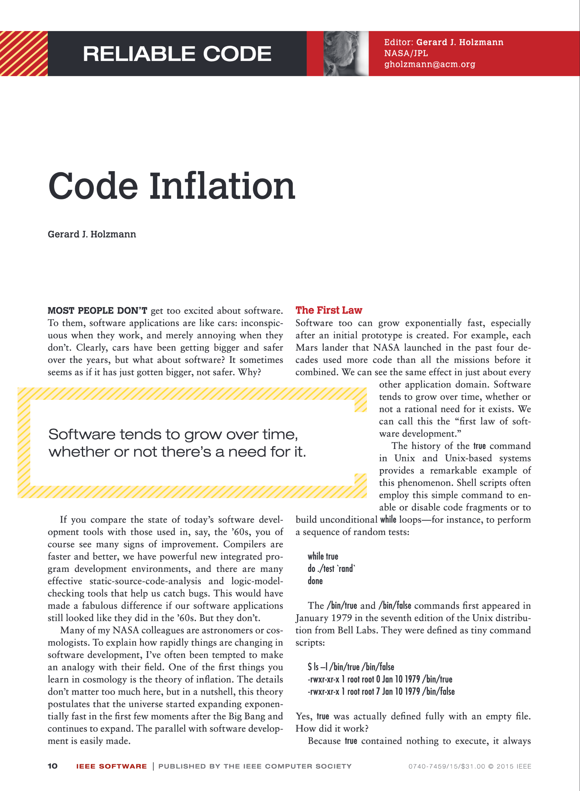
Software tends to grow over time, whether or not there's a need
for it.
Holzmann, G. J. (2015). Code inflation. IEEE Software, 32 (2).

Slide 10
THE HISTORY OF THE true COMMAND
1979
$ ls –l /bin/true
-rwxr-xr-x 1 root root 0 Jan 10 1979 /bin/true
Holzmann, G. J. (2015). Code inflation. IEEE Software, 32 (2).
Notes:
The true command in Unix and Unix-based systems provides a remarkable example of this phenomenon.
Shell scripts often employ this simple command to enable or disable code fragments or to build unconditional while loops—for instance, to perform a sequence of random tests:
In 1979 the true command was an empty file, because it contained nothing to execute, it always completed successfully, returning the success value of zero to the user.

Slide 11
THE HISTORY OF THE true COMMAND
1984
$ ls –l /bin/true
-rwxr-xr-x 1 root root 276 May 14 1984 /bin/true
Holzmann, G. J. (2015). Code inflation. IEEE Software, 32 (2).
Notes:
Then in 1984, things to change, and true grew to 276 bytes.
The contents were now a boilerplate AT&T copyright notice claiming intellectual ownership of the otherwise still empty file.

Slide 12
THE HISTORY OF THE true COMMAND
2010
$ ls –l /bin/true
-rwxr-xr-x 1 root root 8377 Sep 10 2010 /bin/true
Holzmann, G. J. (2015). Code inflation. IEEE Software, 32 (2).
Notes:
In 2010, Solaris distribution increased the size of the shell script with a C source program consisting of a main procedure that called the function _exit(0).
If we compile this program, the size of the executable is more than 8 thousands bytes.

Slide 13
THE HISTORY OF THE true COMMAND
TODAY
$ type true
true is a shell builtin
Holzmann, G. J. (2015). Code inflation. IEEE Software, 32 (2).
Notes:
Today, if we write type true in our terminal we’ll see the following output “true is a shell builtin”
This means that the logic of the executable command is embedded in the shell commands package.
The size of this package is more than 2MB, and it is really difficult to know where is the implementation of the true command there.

Slide 14
Holzmann, G. J. (2015). Code inflation. IEEE Software, 32 (2).
0
?
﻿Size (in bytes) of the true command
Notes:
This bar chart shows the growth in bytes of the size of the true command.
As we can see, the y axis is a logarithmic scale, and today we don’t even know due to the complexities of packaging programs as single executables.
And every one of us has the true command available in our terminal, whether we use it or not.

Slide 15

SOFTWARE BLOAT
Code that is packaged in an application but that is not necessary for building and running the application.
Notes:
This phenomenon is called software bloat.

Slide 16
IT IS A PROBLEM
For size
For security
For maintenance
For performance
Notes:
Software bloat is a problem today.
First, the size of the binaries increases, meaning that we need more resources to store them. This is particularly critical, for example, in embedded systems where the storage capacity is low.
It is a problem for security; shipping more code means that it is easier for an attacker to find vulnerabilities.
It is obviously a problem for maintenance. For example, having dependencies in which only a small part is used means that the developers need to maintain the whole dependency anyways.
And for performance is a problem, for example, in continuous integration environments having more dependencies involve fetching more binaries from external repositories.

Slide 17
STATE-OF-THE-ART MATRIX
GENERIC
UNSOUND
SOUND
DOMAIN SPECIFIC
Notes:
Recently, researchers have started to pay attention to software bloat.
I’ll use this figure to put some related papers and put this work in context.
The x axis represents the soundness of the approach. This is a measure of how effectively the approach is to debloat software.
The y axis means that the approach can be more or less generalized, for example, meaning that it handles any programming language or system.
In 2016, Jiang et al. proposed Jred, a tool to debloat java bytecode using static analysis. The tool is not publicly available, and the approach is not very sound.

Slide 18
STATE-OF-THE-ART MATRIX
GENERIC
UNSOUND
SOUND
JRed
DOMAIN SPECIFIC
Jiang et. al., JRed: Program Customization and Bloatware Mitigation [COMSAC’16]

Slide 19
STATE-OF-THE-ART MATRIX
GENERIC
UNSOUND
SOUND
JRed
RAZOR
DOMAIN SPECIFIC
﻿Quian et. al., RAZOR: A Framework for Post-deployment Software Debloating [USENIX’19]
Notes:
In 2019, RAZOR was published at USENIX.
This is a tool that relies on dynamic analysis to debloat small programs written in C.
It performs the debloat following some user specification and the debloat is not automatic.

Slide 20
STATE-OF-THE-ART MATRIX
GENERIC
JShrink
UNSOUND
SOUND
JRed
RAZOR
DOMAIN SPECIFIC
Bruce et. al., JShrink: In-depth Investigation into Debloating Modern Java Applications [FSE’20]
Notes:
In 2020, Bruce et.al. published a paper with a tool called JShrink at FSE.
And the goal of this paper was to show the limitations of the current tools to debloat Java code.
So, this paper shows that debloating Java bytecode is really hard in practice.

Slide 21
STATE-OF-THE-ART MATRIX
GENERIC
JShrink
UNSOUND
SOUND
JRed
RAZOR
DOMAIN SPECIFIC
﻿THIS WORK!
Notes:
In this work, we want to contribute to the state-of-the-art of software debloat by creating tools and techniques based on static and dynamic analysis to debloat Java code effectively.

Slide 22
STATE-OF-THE-ART MATRIX
GENERIC
Static + dynamic
analysis
JShrink
UNSOUND
SOUND
Java
JRed
RAZOR
DOMAIN SPECIFIC
﻿THIS WORK!

Slide 23
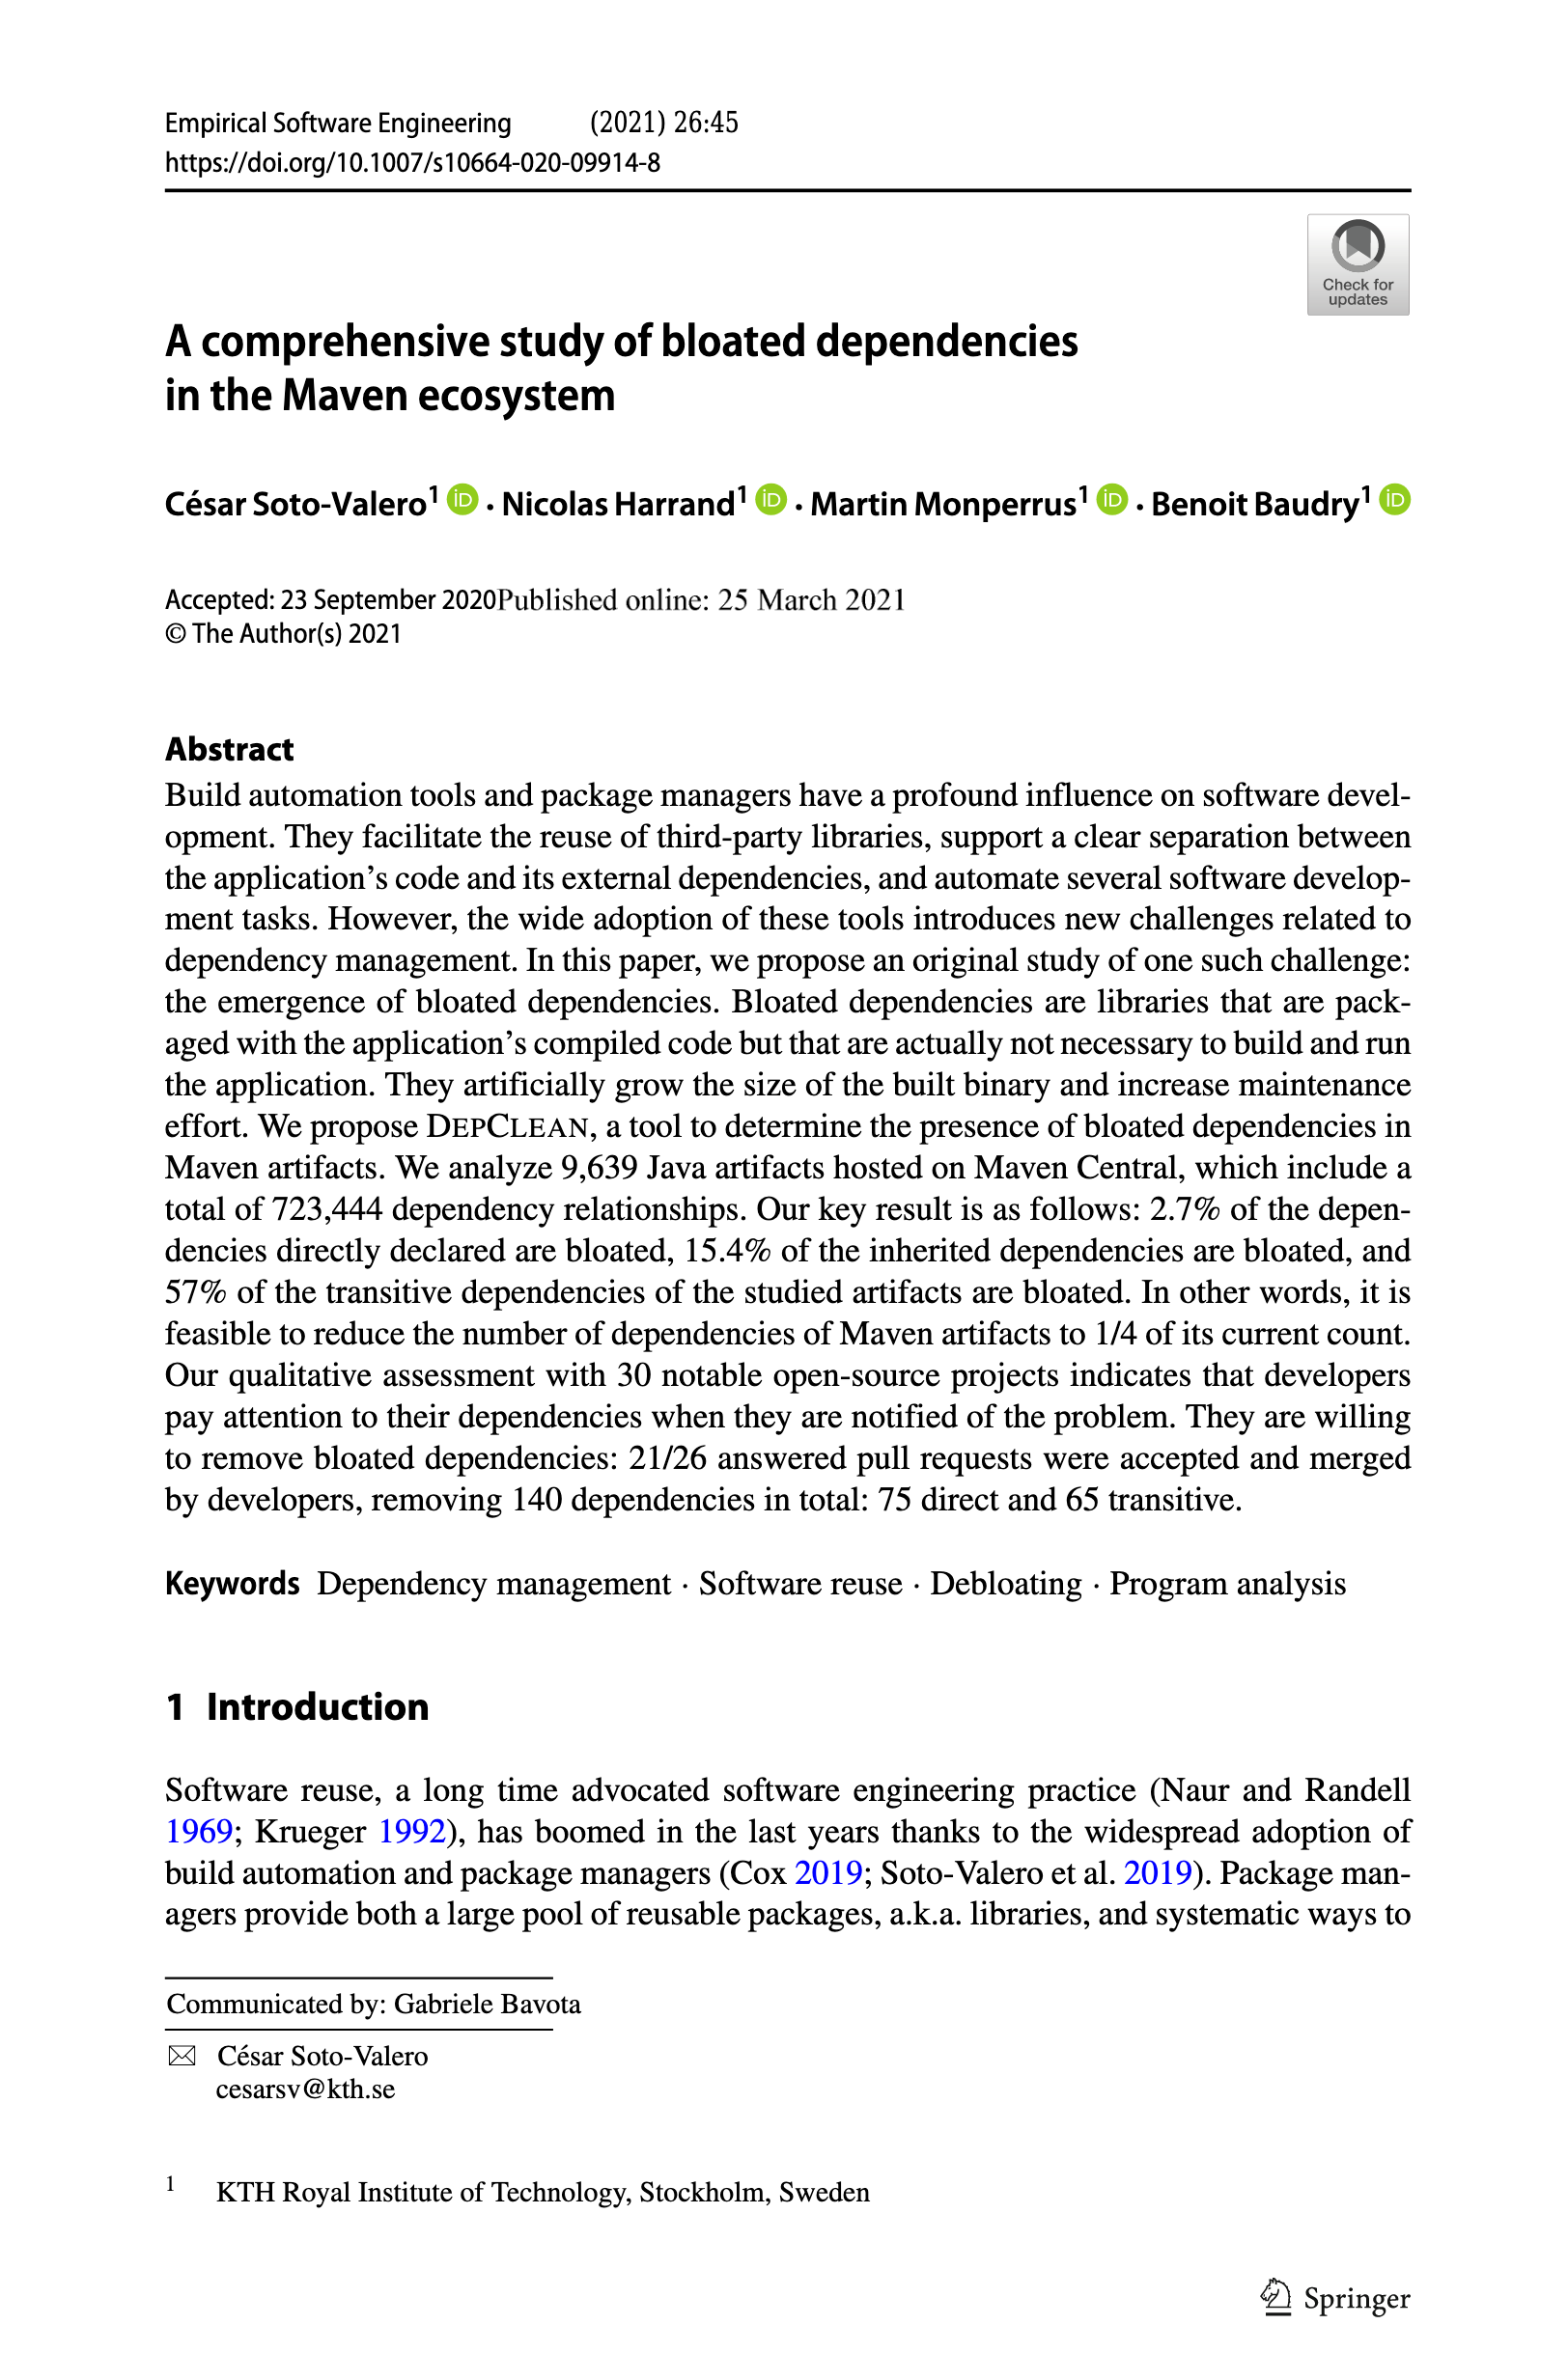
1st CONTRIBUTION
DepClean: Automatically detecting and removing
bloated dependencies in Maven projects

Slide 24
OVERVIEW

Slide 25
OVERVIEW
P

Slide 26
OVERVIEW
P
<dependency> <groupId>org.A</groupId> <artifactId>A</artifactId> </dependency>
<dependency> <groupId>org.B</groupId> <artifactId>B</artifactId> </dependency>
<dependency> <groupId>org.C</groupId> <artifactId>C</artifactId> </dependency>

Slide 27
OVERVIEW
P

Slide 28
OVERVIEW
P
A
B
C

Slide 29
OVERVIEW
P
Direct dependencies
A
B
C

Slide 30
OVERVIEW
P
A
B
C

Slide 31
OVERVIEW
P
A
B
C
D
E
F

Slide 32
OVERVIEW
P
A
B
C
Transitive dependencies
D
E
F

Slide 33
OVERVIEW
P
A
B
C
D
E
F

Slide 34
OVERVIEW
Q
P
A
B
C
D
E
F

Slide 35
OVERVIEW
Q
<parent> <groupId>org.Q</groupId> <artifactId>Q</artifactId> </parent>
P
A
B
C
D
E
F

Slide 36
OVERVIEW
Q
P
A
B
C
D
E
F

Slide 37
OVERVIEW
Q
P
G
A
B
C
D
E
F

Slide 38
OVERVIEW
Q
Inherited dependency
P
G
A
B
C
D
E
F

Slide 39
OVERVIEW
Q
Inherited dependency
P
G
Direct dependencies
A
B
C
Transitive dependencies
D
E
F

Slide 40
PROBLEM
Q
P
G
A
B
C
D
E
F

Slide 41
PROBLEM
Q
P
G
A
B
C
D
E
F

Slide 42
PROBLEM
P
A
D
F

Slide 43
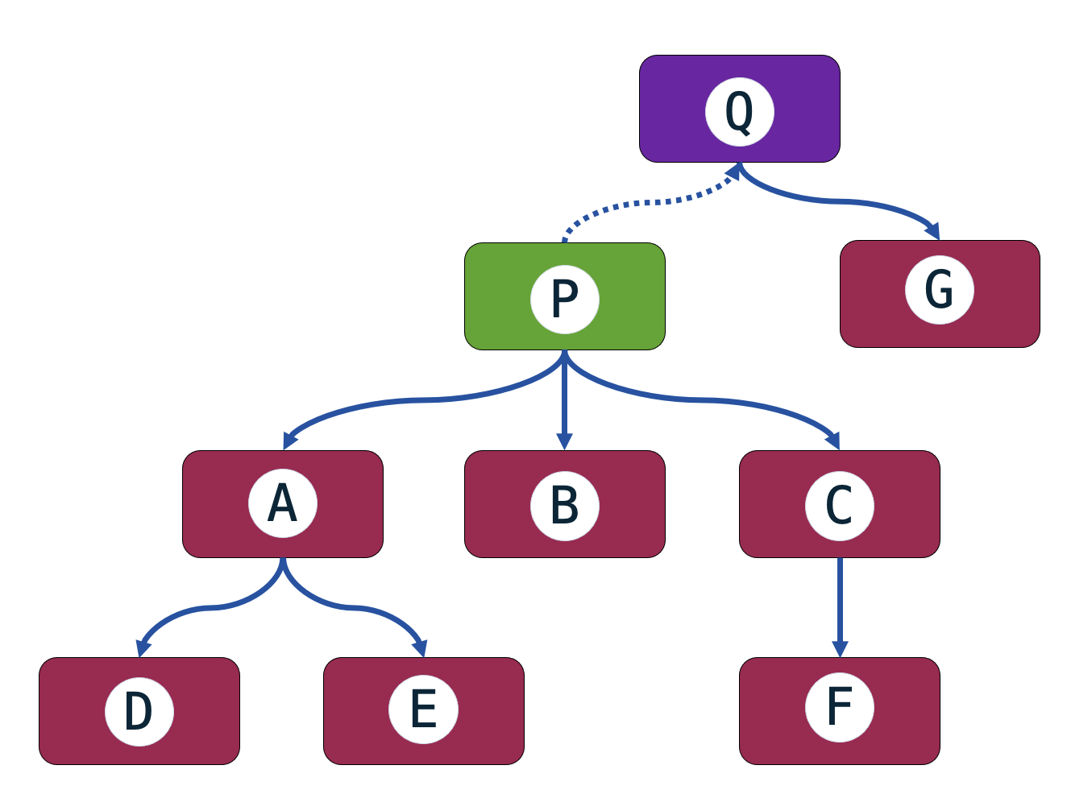
PROBLEM

Slide 44
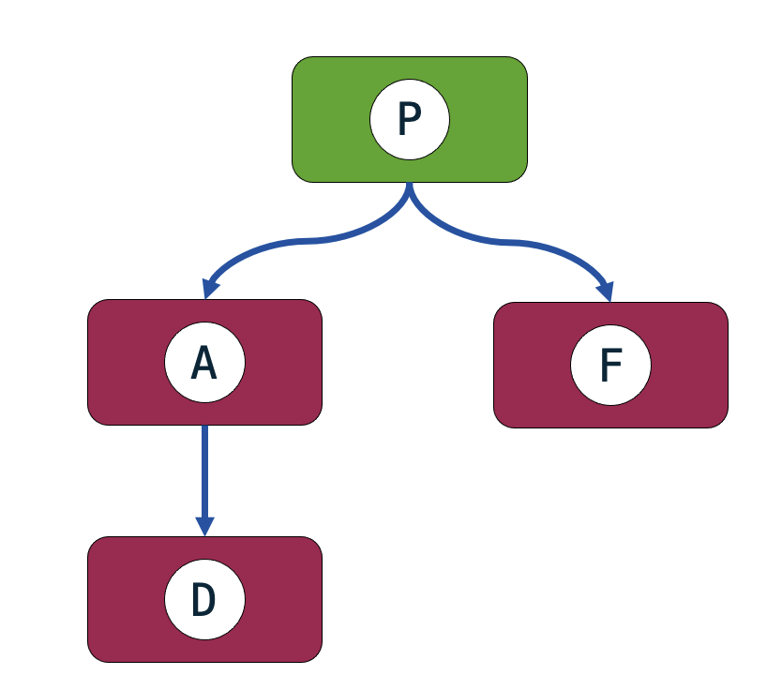
PROBLEM

Slide 45
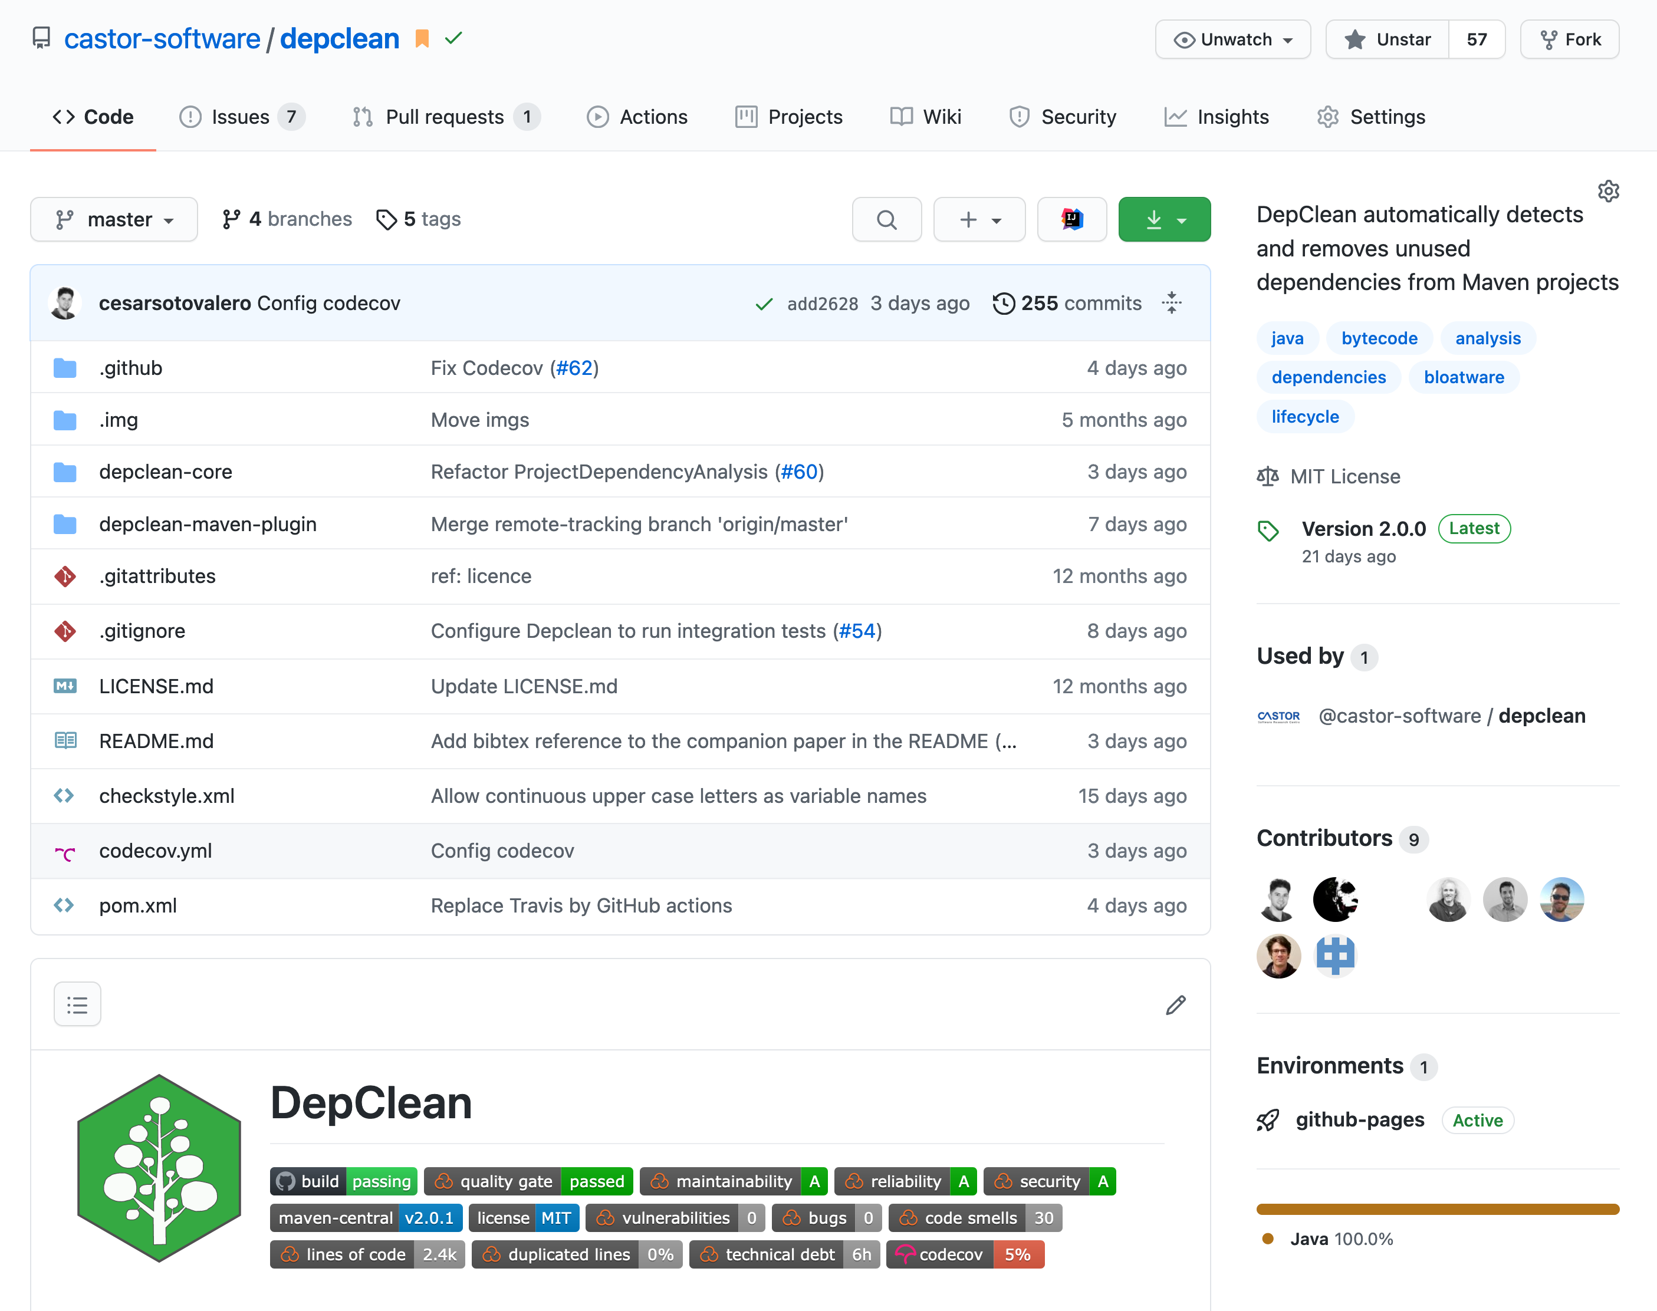
DEPCLEAN TOOL
https://github.com/castor-software/depclean

Slide 46
DEPCLEAN TOOL
https://github.com/castor-software/depclean
Uses advanced static bytecode analysis to detect and remove bloated dependencies

Slide 47
DEPCLEAN TOOL
https://github.com/castor-software/depclean
Uses advanced static bytecode analysis to detect and remove bloated dependencies
Automatic generation of a debloated POM file

Slide 48
DEPCLEAN TOOL
https://github.com/castor-software/depclean
Uses advanced static bytecode analysis to detect and remove bloated dependencies
Automatic generation of a debloated POM file
Maven plugin easy to integrate in a CI pipeline

Slide 49
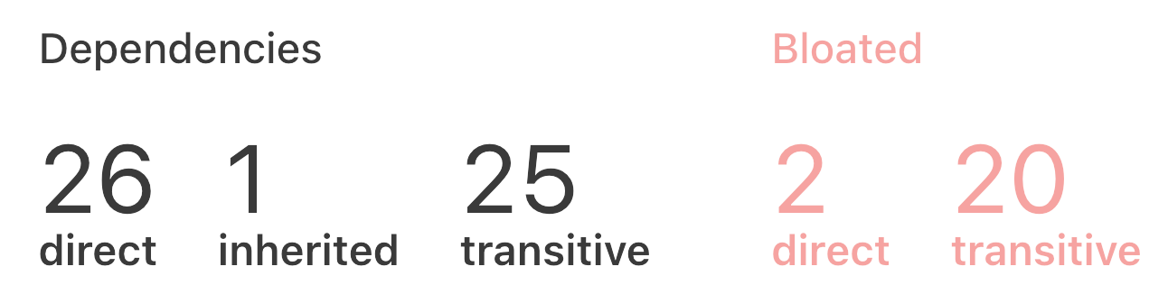
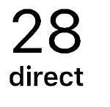
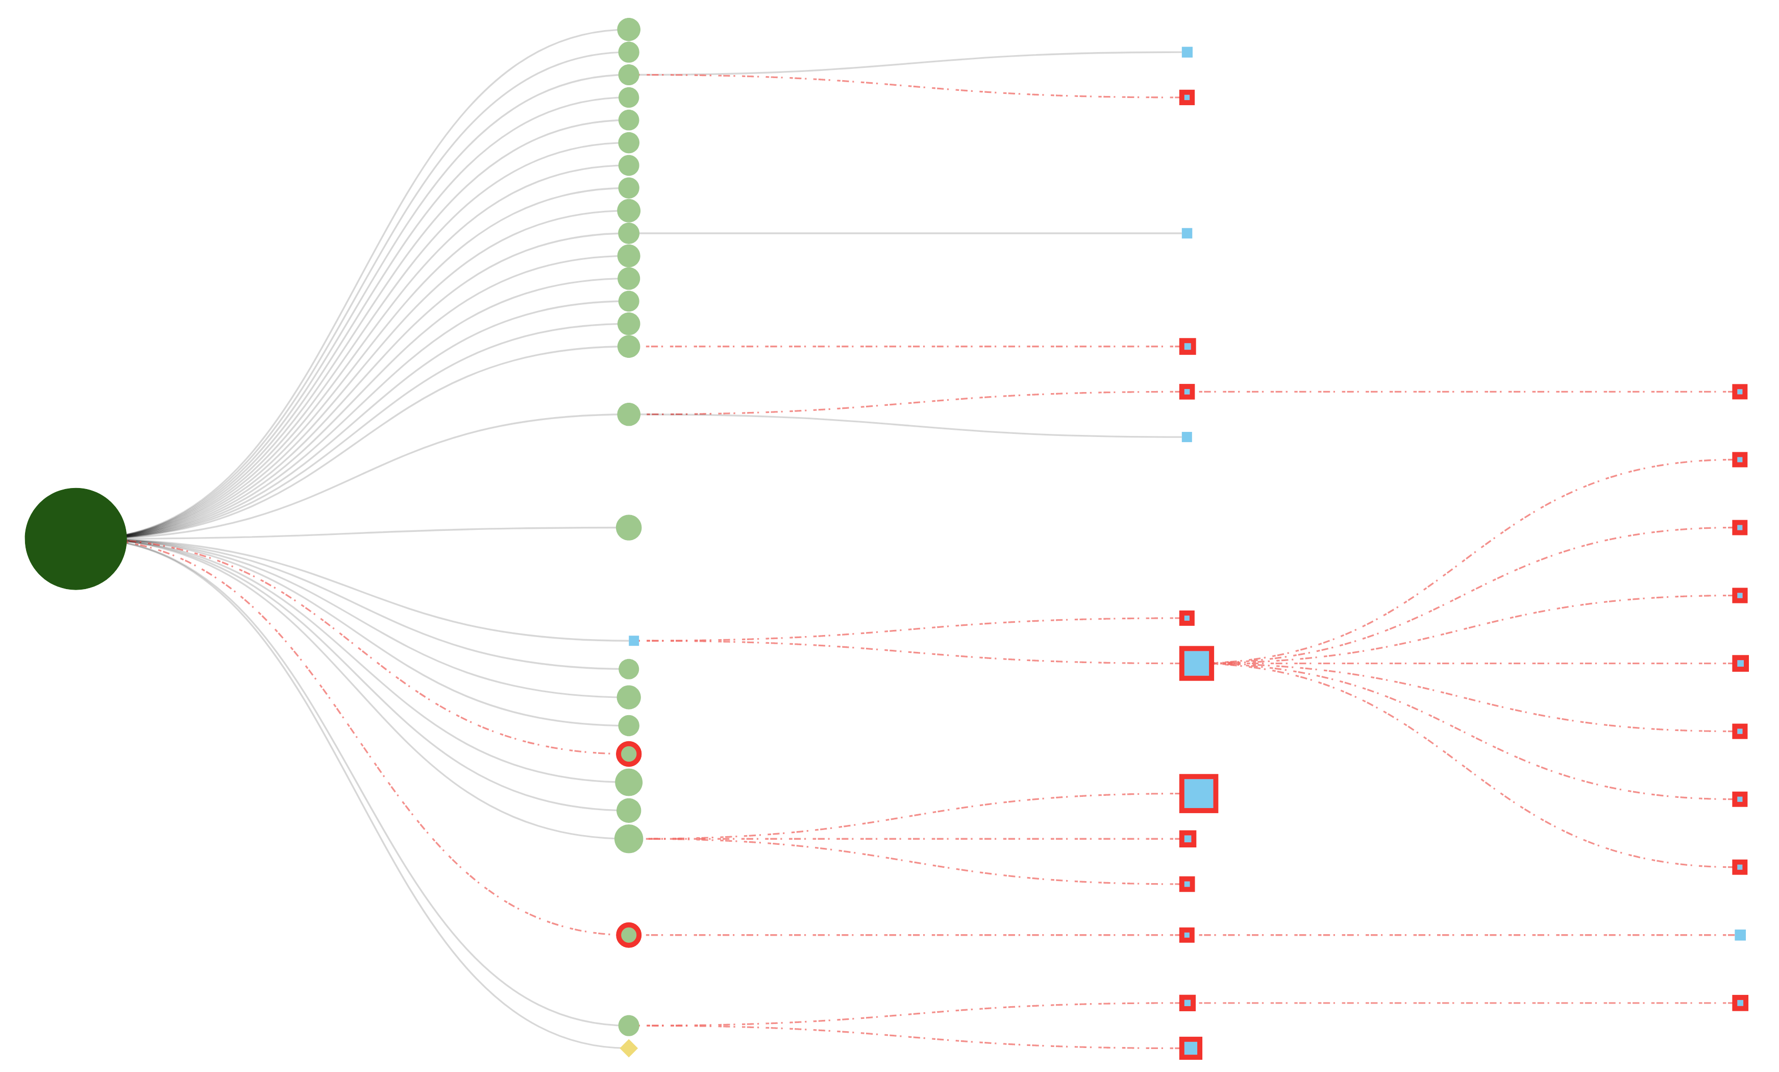
Example: maven-core project (v3.7.0)
https://github.com/castor-software/depclean-web
Notes:
Let’s me present an example of what DepClean can do.
We have developed a web tool for the visualization of the dependency trees analyzed with DepClean.
This example corresponds to the maven core project.
DepClean can analyze this dependency tree and termine that 2 direct dependencies and 20 transitive dependencies are bloated, which means that they can be removing without affecting the project build.

Slide 50
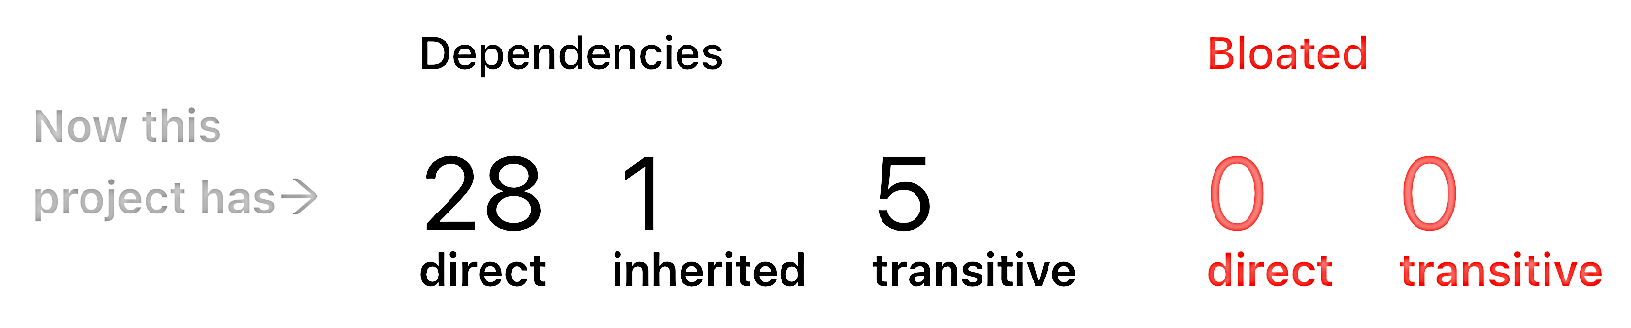
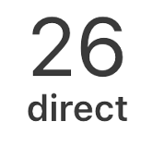
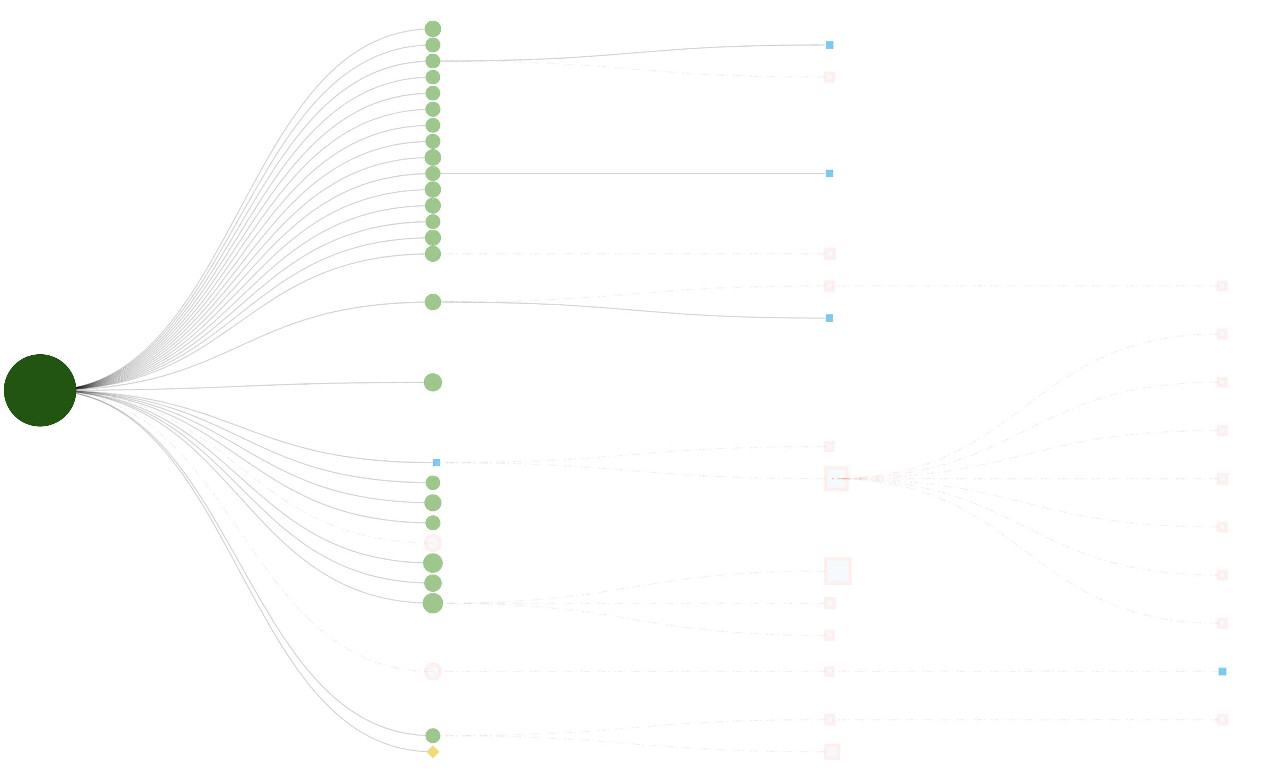
Example: maven-core project (v3.7.0)
https://github.com/castor-software/depclean-web

Slide 51
HOW MUCH DEPENDENCY BLOAT EXISTS?
Notes:
But the question is: How much dependency bloat exists out there?
We have made a large scale empirical study to determine how much dependency bloat exists in Maven central.
So, based according to this result, dependency bloat exists and it is problem.
But the question is… do developers care about it?

Slide 52
HOW MUCH DEPENDENCY BLOAT EXISTS?
9K artifacts and 723K dependencies

Slide 53
HOW MUCH DEPENDENCY BLOAT EXISTS?
9K artifacts and 723K dependencies
2.7% of direct dependencies are bloated
15.1% of inherited dependencies are bloated
57% of transitive dependencies are bloated

Slide 54
ARE DEVOPERS WILLING TO REMOVE BLOAT?

Slide 55
ARE DEVOPERS WILLING TO REMOVE BLOAT?
USER STUDY ON 30 PROJECTS
Jenkins
Neo4j
Flink
Spoon
Checkstyle
CoreNLP
jHiccup
Alluxio
TeaVM
…
Full list: https://tinyurl.com/depclean-experiments

Slide 56
ARE DEVOPERS WILLING TO REMOVE BLOAT?
30 pull requests in 30 notable open source projects

Slide 57
ARE DEVOPERS WILLING TO REMOVE BLOAT?
30 pull requests in 30 notable open source projects
Removed 140 bloated dependencies in 21 projects thanks to DepClean

Slide 58
SUMMARY OF 1st CONTRIBUTION

Slide 59
SUMMARY OF 1st CONTRIBUTION
There is a lot of code bloat in Maven Central
Caused by the induced transitive dependencies
Caused by the heritage mechanism of multi-module projects
Caused by software development practices

Slide 60
SUMMARY OF 1st CONTRIBUTION
There is a lot of code bloat in Maven Central
Caused by the induced transitive dependencies
Caused by the heritage mechanism of multi-module projects
Caused by software development practices
Software developers care
They are willing to remove bloated dependencies

Slide 61
SUMMARY OF 1st CONTRIBUTION
There is a lot of code bloat in Maven Central
Caused by the induced transitive dependencies
Caused by the heritage mechanism of multi-module projects
Caused by software development practices
Software developers care
They are willing to remove bloated dependencies
DepClean
It is useful to automatically detect and remove bloated dependencies

Slide 62
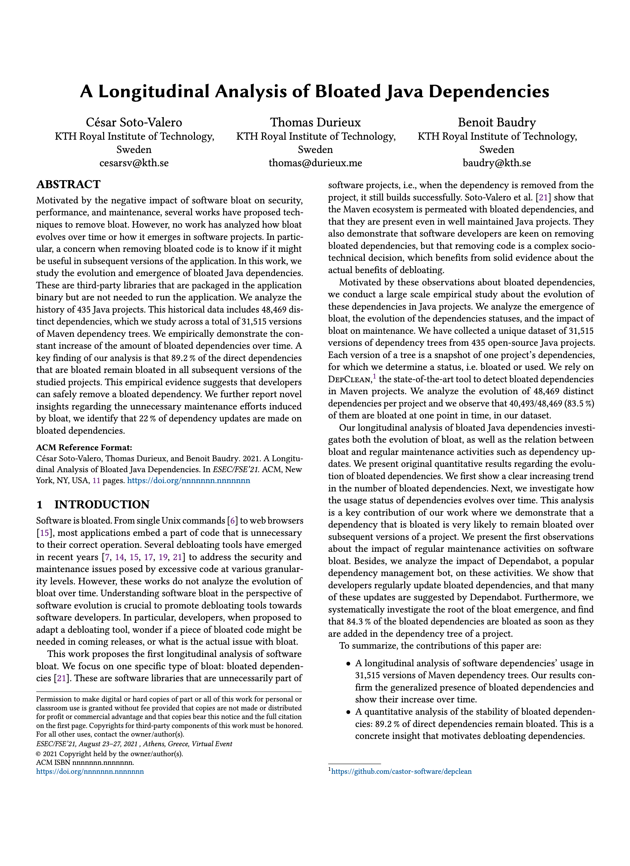
2nd CONTRIBUTION
Longitudinal Analysis of Bloated Java Dependencies
Notes:
In previous part, I presented DepClean and how it helps to remove bloated dependencies.
But a fundamental questions is: What if something bloated today is not bloated tomorrows?

Slide 63
PROBLEM
Notes:
Because, the problem is that, as we know, software evolves over time.
The question is… when this dependency is bloated at version 1, it is also bloated at version 2, and soon…

Slide 64
PROBLEM
SOFTWARE EVOLVES OVER TIME
Time

Slide 65
PROBLEM
v₁
P
SOFTWARE EVOLVES OVER TIME
Time

Slide 66

PROBLEM
v₁
v₂
P
P
A
B
SOFTWARE EVOLVES OVER TIME
Time

Slide 67
PROBLEM
v₁
v₂
v₃
P
P
P
A
B
A
B
C
D
SOFTWARE EVOLVES OVER TIME
Time

Slide 68
PROBLEM
v₁
v₂
v₃
v₄
P
P
P
P
A
B
A
B
A
B
C
D
C
D
SOFTWARE EVOLVES OVER TIME
Time

Slide 69
HOW DOES THE USAGE STATUS EVOLVES?
Notes:
450 projects

Slide 70
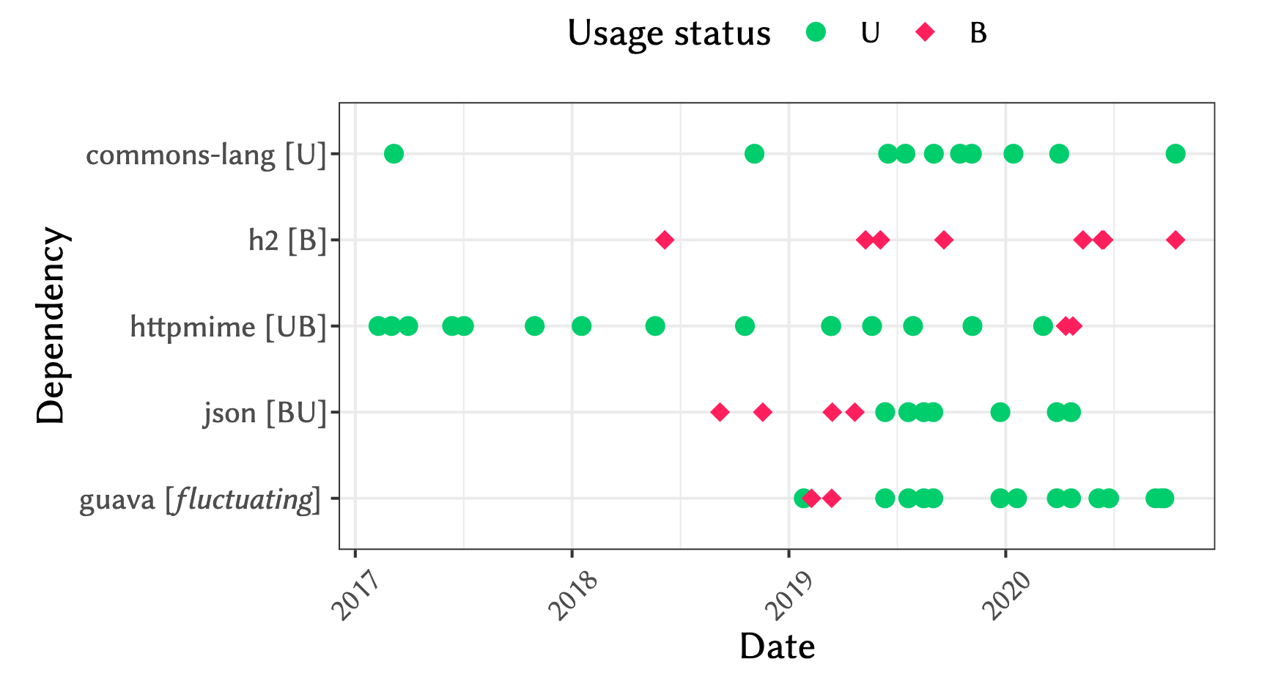

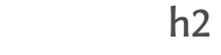



HOW DOES THE USAGE STATUS EVOLVES?

Slide 71
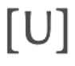
HOW DOES THE USAGE STATUS EVOLVES?

Slide 72
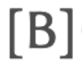
HOW DOES THE USAGE STATUS EVOLVES?

Slide 73

HOW DOES THE USAGE STATUS EVOLVES?

Slide 74

HOW DOES THE USAGE STATUS EVOLVES?

Slide 75

HOW DOES THE USAGE STATUS EVOLVES?

Slide 76
HOW DOES THE USAGE STATUS EVOLVES?
Notes:
We analyzed the status of the dependencies in 450 projects over time
The status 94% of direct dependencies doesn't change
The status 91% of transitive dependencies doesn't change

Slide 77
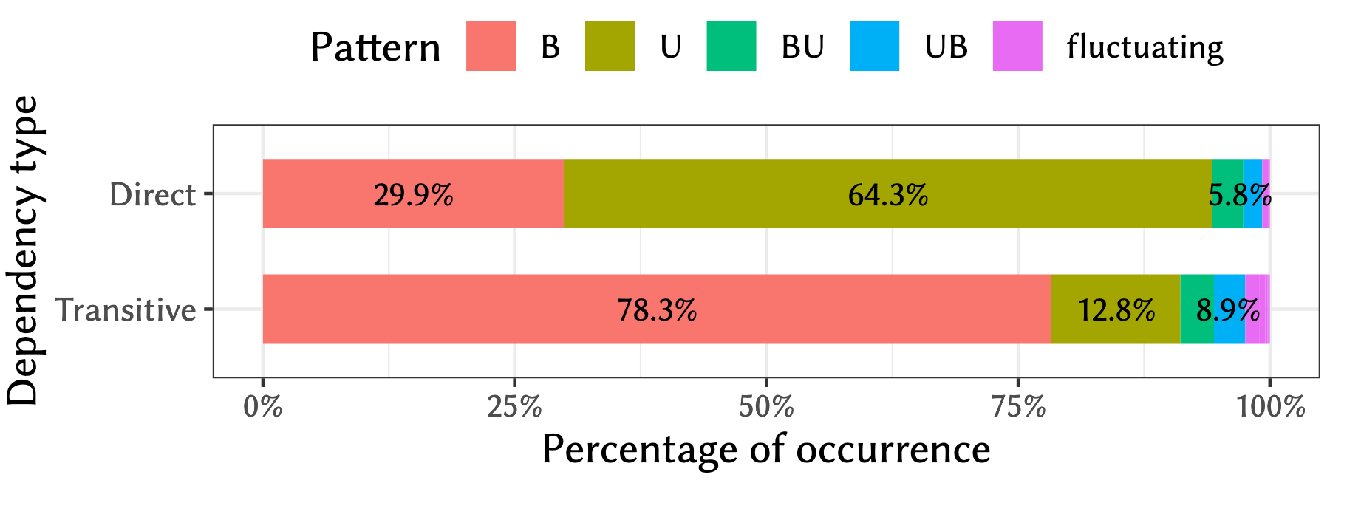
HOW DOES THE USAGE STATUS EVOLVES?

Slide 78
HOW DOES THE USAGE STATUS EVOLVES?

Slide 79
HOW DOES THE USAGE STATUS EVOLVES?

Slide 80
HOW DOES THE USAGE STATUS EVOLVES?

Slide 81
DO DEVELOPERS UPDATE BLOATED DEPENDENCIES?

Slide 82
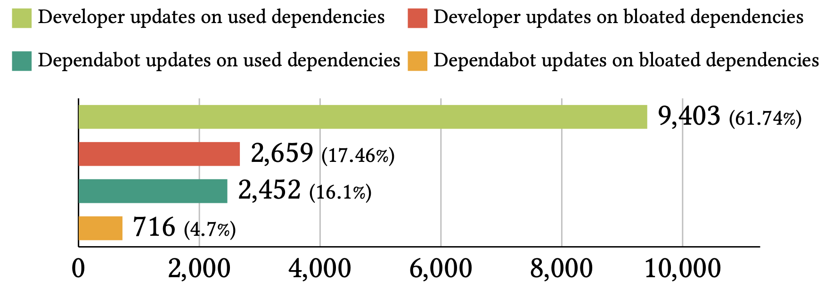
DO DEVELOPERS UPDATE BLOATED DEPENDENCIES?

Slide 83
DO DEVELOPERS UPDATE BLOATED DEPENDENCIES?

Slide 84
DO DEVELOPERS UPDATE BLOATED DEPENDENCIES?

Slide 85
DO DEVELOPERS UPDATE BLOATED DEPENDENCIES?

Slide 86
SUMMARY OF 2nd CONTRIBUTION

Slide 87
SUMMARY OF 2nd CONTRIBUTION
The usage status of dependencies is mostly constant over time
It is safe to debloat dependencies (> 90% of dependencies do not change)

Slide 88
SUMMARY OF 2nd CONTRIBUTION
The usage status of dependencies is mostly constant over time
It is safe to debloat dependencies (> 90% of dependencies do not change)
Developers often update bloated dependencies
An unnecessary maintenance effort due to the lack of tools

Slide 89
SUMMARY OF 2nd CONTRIBUTION
The usage status of dependencies is mostly constant over time
It is safe to debloat dependencies (> 90% of dependencies do not change)
Developers often update bloated dependencies
An unnecessary maintenance effort due to the lack of tools
Some dependency updates are suggested by Dependabot
First empirical evidence of false alarms related to dependency management caused by bots

Slide 90
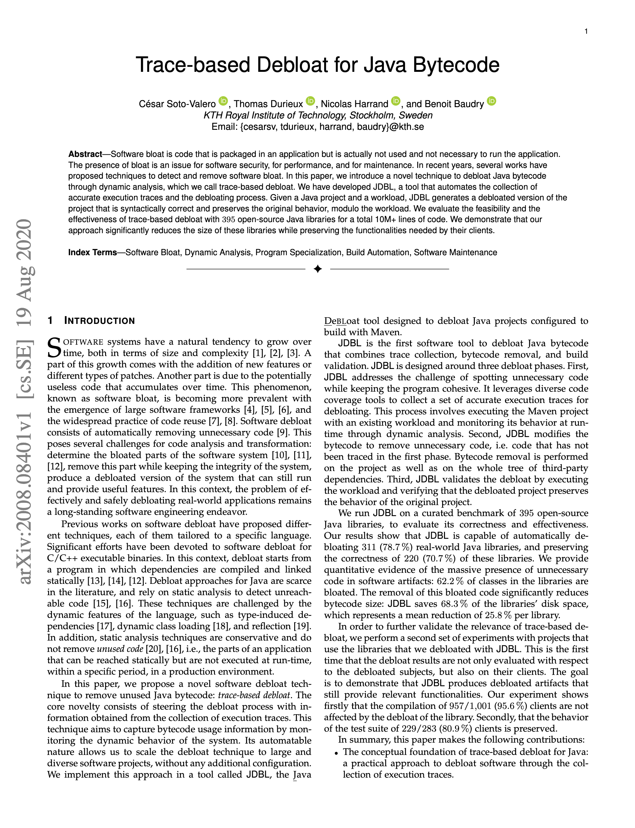
3rd CONTRIBUTION
JDBL: Trace-based Debloat for Java Bytecode
Notes:
TSE is at the moment the top journal in Software Engineering

Slide 91
PROBLEM
Q
P
G
A
B
C
D
E
F
Notes:
RECALL WE HAD THE DEPENDENCY TREE IN CONTRIBUTION 1
MORE PRECISE, MORE FINE GRAIN, TRACE BASED, EXECUTE THE PROGRAM WITH SOME INPUT, THE KNOWNLEGE IS IN THE TRACES, WHAT IS THE CHALLENGES, TO DO IT
STATIC ANALYSISI IS AN OVER APPROXIMATION
DEBLOAT INSIDE THE ROOT OF THE DEPENDENCY TREE

Slide 92
PROBLEM
Input
P
A
D
F

Slide 93
PROBLEM
Input

Slide 94
PROBLEM

Slide 95
PROBLEM

Slide 96
PROBLEM
Input
P

Slide 97
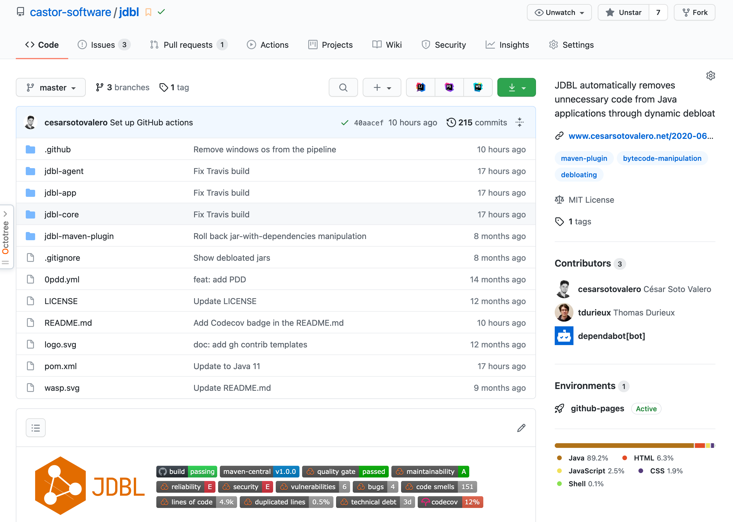
JDBL TOOL
https://github.com/castor-software/jdbl

Slide 98
JDBL TOOL
https://github.com/castor-software/jdbl
Relies on dynamic analysis to collect execution traces at runtime

Slide 99
JDBL TOOL
https://github.com/castor-software/jdbl
Relies on dynamic analysis to collect execution traces at runtime
Automatically remove unused classes and methods

Slide 100
JDBL TOOL
https://github.com/castor-software/jdbl
Relies on dynamic analysis to collect execution traces at runtime
Automatically remove unused classes and methods
Package the debloated application

Slide 101
APPROACH
JDBL
Notes:
EXECUTING THE PROJECT, GETTING TRACES, MONITORING, VALIDATION

Slide 102
APPROACH
Input
Project
Workload
JDBL

Slide 103
APPROACH
Input
Project
1
Trace
Workload
JDBL

Slide 104
APPROACH
Input
Project
1
2
Trace
Remove
Workload
JDBL

Slide 105
APPROACH
Input
Project
1
2
3
Trace
Remove
Validate
Workload
JDBL

Slide 106
APPROACH
Input
Output
Project
1
2
3
JAR
Trace
Remove
Validate
Workload
JDBL

Slide 107
CAN JDBL DEBLOAT AUTOMATICALLY?
Notes:
395 libraries

Slide 108
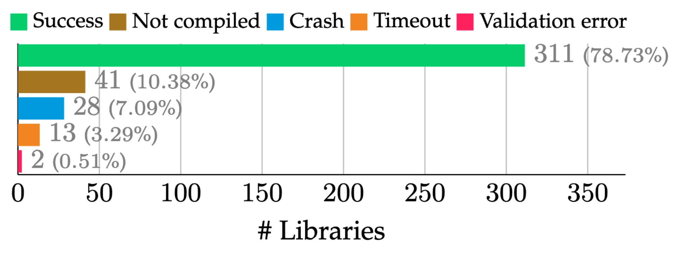
CAN JDBL DEBLOAT AUTOMATICALLY?

Slide 109
IS THE BEHAVIOUR PRESERVED?
Notes:
311
To what extent do the debloated versions preserve their originalbehavior?

Slide 110
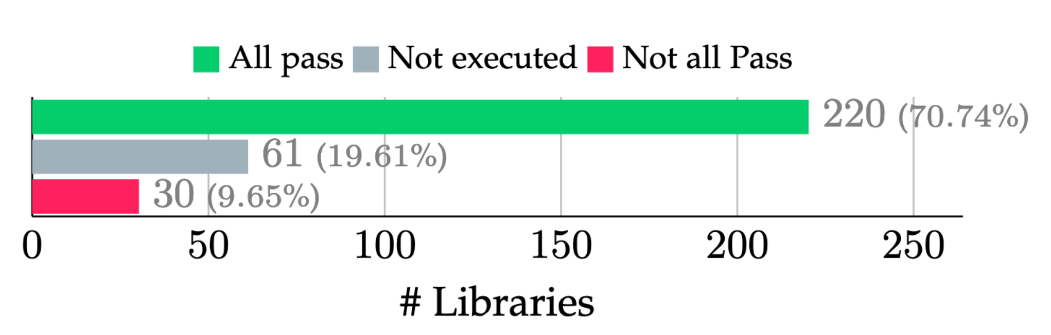
IS THE BEHAVIOUR PRESERVED?

Slide 111
WHAT IS THE BENEFIT?

Slide 112
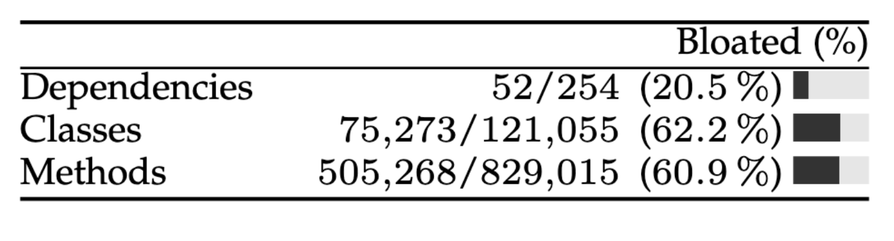
WHAT IS THE BENEFIT?

Slide 113
ARE THE CLIENTS AFFECTED?
Notes:
To what extent do the debloated versions preserve their originalbehavior?
Results of the tests on the 283 clients that cover at leastone debloated library.

Slide 114
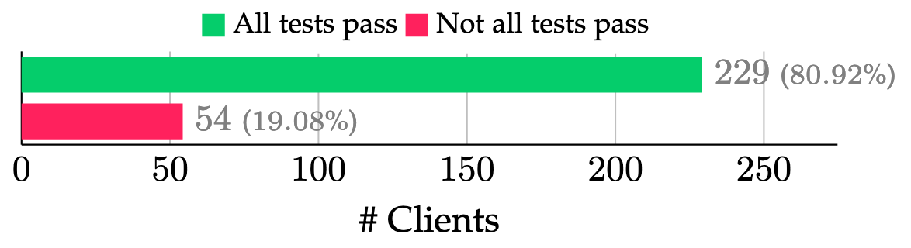
ARE THE CLIENTS AFFECTED?

Slide 115
SUMMARY OF 3rd CONTRIBUTION

Slide 116
SUMMARY OF 3rd CONTRIBUTION
Trace-based debloat is doable
> 78% successfully debloated libraries

Slide 117
SUMMARY OF 3rd CONTRIBUTION
Trace-based debloat is doable
> 78% successfully debloated libraries
Debloated libraries preserve the original behaviour
> 70% libraries are not affected

Slide 118
SUMMARY OF 3rd CONTRIBUTION
Trace-based debloat is doable
> 78% successfully debloated libraries
Debloated libraries preserve the original behaviour
> 70% libraries are not affected
Debloated libraries are
> 50% smaller than the original

Slide 119
SUMMARY OF 3rd CONTRIBUTION
Trace-based debloat is doable
> 78% successfully debloated libraries
Debloated libraries preserve the original behaviour
> 70% libraries are not affected
Debloated libraries are
> 50% smaller than the original
Library clients preserve the original behaviour
> 80% clients are not affected

Slide 120
LESSONS LEARNED

Slide 121
LESSONS LEARNED

Slide 122
LESSONS LEARNED
Debloat is hard in practice
Determining what is actually used is not trivial
Static + Dynamic analysis may help

Slide 123
LESSONS LEARNED
Debloat is hard in practice
Determining what is actually used is not trivial
Static + Dynamic analysis may help
Debloat is relevant
Package ecosystems are bloated
Developers are willing to debloat software
More tools are needed for this purpose

Slide 124
FUTURE WORK

Slide 125
FUTURE WORK
End-to-end software debloat

Slide 126
FUTURE WORK
End-to-end software debloat
Debloat containers

Slide 127
FUTURE WORK
End-to-end software debloat
Debloat containers
Debloat specific features

Slide 128
FUTURE WORK
End-to-end software debloat
Debloat containers
Debloat specific features
Debloat test suites

Slide 129
PHD PROGRESS

Slide 130
PAPERS DIRECTLY RELATED
César Soto-Valero, Thomas Durieux, Nicolas Harrand, Benoit Baudry. Trace-based Debloat for Java Bytecode [Submitted to TSE]
César Soto-Valero, Thomas Durieux, Benoit Baudry. A Longitudinal Analysis of Bloated Java Dependencies [Submitted to FSE]
Thomas Durieux, César Soto-Valero, Benoit Baudry. DUETS: A Dataset of Reproducible Pairs of Java Library-Clients [MSR’21]
César Soto-Valero, Nicolas Harrand, Martin Monperrus, Benoit Baudry. A Comprehensive Study of Bloated Dependencies in the Maven Ecosystem [EMSE’20]
César Soto-Valero, Amine Benelallam, Nicolas Harrand, Olivier Barais, Benoit Baudry. The Emergence of Software Diversity in Maven Central [MSR’19]
Full list: https://www.cesarsotovalero.net/publications

Slide 131
OTHER PAPERS
Nicolas Harrand, Amine Benelallam, César Soto-Valero, Olivier Barais, Benoit Baudry. Analyzing 2.3 Million Maven Dependencies to Reveal an Essential Core in APIs [Submitted to JSS]
Gustaf Halvardsson, Johanna Peterson, César Soto-Valero, Benoit Baudry. Interpretation of Swedish Sign Language using Convolutional Neural Networks and Transfer Learning [SNCS’21]
Nicolas Harrand, César Soto-Valero, Martin Monperrus, Benoit Baudry. Java Decompiler Diversity and its Application to Meta-decompilation [JSS’20]
Raúl Reina, David Barbado, César Soto-Valero, José M. Sarabia and Alba Roldán. Evaluation of the Bilateral Function in Para-athletes with Spastic Hemiplegia: a Model-based Clustering Approach [JSAMS’20]
Amine Benelallam, Nicolas Harrand, César Soto-Valero, Benoit Baudry, Olivier Barais. The Maven Dependency Graph: a Temporal Graph-based Representation of Maven Central [MSR’19]
Nicolas Harrand, César Soto-Valero, Martin Monperrus, Benoit Baudry. The Strengths and Behavioral Quirks of Java Bytecode Decompilers [SCAM’19]
César Soto-Valero, Miguel Pic. Assessing the Causal Impact of the 3-point Per Victory Scoring System in the Competitive Balance of LaLiga [IJCSS’19]
César Soto-Valero, Yohan Bourcier, Benoit Baudry. Detection and Analysis of Behavioral T-patterns in Debugging Activities [MSR’18]
Full list: https://www.cesarsotovalero.net/publications

Slide 132
TEACHER ASSISTANT
DD2482 Automated Software Testing and DevOps, worked with Martin Monperrus & Benoit Baudry at KTH, Spring 2021
WASP Software Engineering and Cloud Computing, worked with Martin Monperrus & Benoit Baudry at KTH, Spring 2021
DD2480 Software Engineering Fundamentals, worked with Cyrille Artho at KTH, Spring 2021
DD1369 Software Engineering in Project Form, worked with Dena Hussain at KTH, Fall 2020
DD2460 Software Safety and Security, worked with Cyrille Artho at KTH, Spring 2020
DD2482 Automated Software Testing and DevOps, worked with Martin Monperrus & Benoit Baudry at KTH, Spring 2020
DM1590 Machine Learning for Media Technology, worked with Bob Sturm at KTH, Spring 2020
DA2210 Introduction to the Philosophy of Science and Research Methodology for Computer Scientists, worked with Linda Kann at KTH, Fall 2019
WASP Software Engineering and Cloud Computing, worked with Martin Monperrus & Benoit Baudry at KTH, Spring 2019
ID2211 Data Mining, Basic Course, worked with Sarunas Girdzijauskas at KTH, Spring 2019
Full list: https://www.cesarsotovalero.net/service

Slide 133
Notes:
ACADEMIC IMPACT + OUTREACH IMPACT

Slide 134
57 CREDITS
10 courses completed

Slide 135
57 CREDITS
10 courses completed
3 SUPERVISIONS
2 BSc + 1 MSc

Slide 136
57 CREDITS
10 courses completed
3 SUPERVISIONS
2 BSc + 1 MSc
8 PAPERS REVIEWED
3 as primary reviewer + 5 as sub-reviewer

Slide 137
57 CREDITS
10 courses completed
3 SUPERVISIONS
2 BSc + 1 MSc
8 PAPERS REVIEWED
3 as primary reviewer + 5 as sub-reviewer
99 CITATIONS
Slow and steady wins the race

Slide 138
Notes:
ACADEMIC IMPACT + OUTREACH IMPACT

Slide 139
3 PROJECTS
DepAnalyzer + DepClean + JDBL

Slide 140
3 PROJECTS
DepAnalyzer + DepClean + JDBL
10+ TRIPS
4 Countries

Slide 141

3 PROJECTS
DepAnalyzer + DepClean + JDBL
10+ TRIPS
4 Countries

Slide 142
3 PROJECTS
DepAnalyzer + DepClean + JDBL
10+ TRIPS
4 Countries
50+ MERGED PRs
Still low, more to come!

Slide 143
3 PROJECTS
DepAnalyzer + DepClean + JDBL
10+ TRIPS
4 Countries
50+ MERGED PRs
Still low, more to come!
12 PRESENTATIONS
e.g., SL, FOSDEM’21

Slide 144

1 BABY
The greatest challenge!

Slide 145
THANKS!
Any questions?
You can find me at:
cesarsv@kth.se
https://www.cesarsotovalero.net

